Slide 1
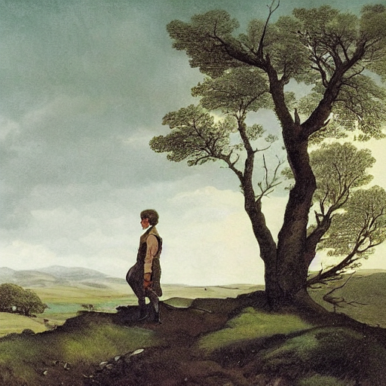
"This is certainly a beautiful country! In all
I do not believe that I could have fixed on a
so completely removed from the stir of
A perfect misanthropist's heaven"

Slide 2
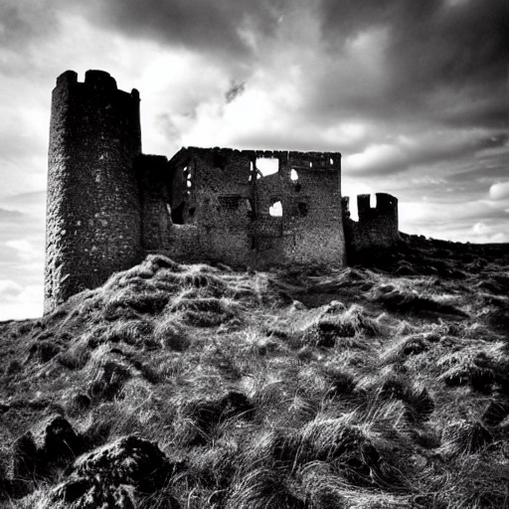
Wuthering Heights is the name of Mr. Heathcliff's dwelling. The architect had foresight to
it strong. The narrow windows are deeply set in the wall, and the corners defended with large
stones.

Slide 3
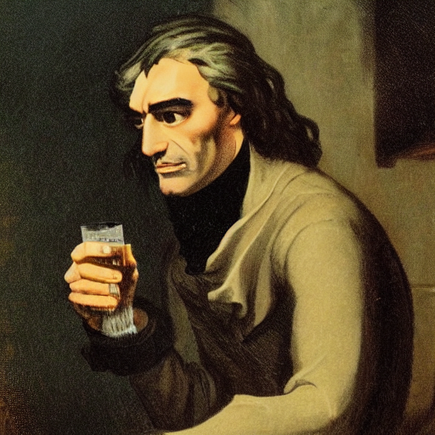
Mr. Heathcliff is a dark-skinned gipsy in
in dress and manners a gentleman. He is
slovenly, perhaps, yet not looking amiss
his negligence. He has an erect and
figure; and rather morose.

Slide 4
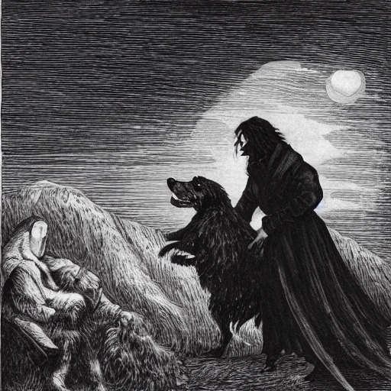
'You'd better let the dog alone,' growled Mr. Heathcliff. 'She's not accustomed to be
kept for a pet'

Slide 5
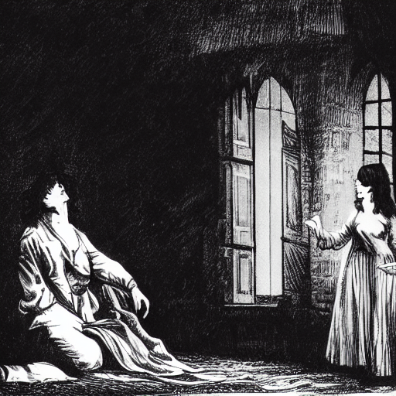
I bowed and returned the pledge; beginning to perceive that it would be foolish to sit sulking
the misbehaviour of a pack of curs. I felt loth to yield the fellow further amusement at my
since his humour took that turn. He--probably swayed by prudential consideration of the folly
offending a good tenant--relaxed a little in the laconic style of chipping off his pronouns and
verbs.

